Slide 1

NASA TMR RISC-V MCU for CWS
ECEN 499
Chris Porter, Kyle Toliver, Spencer Cheney,
Jonah Boe

Slide 2
Overview:
Purpose
Goals
Hardware & Software
Libero
SoftConsole
Future Areas of Improvement

Slide 3
Purpose:
Using the PolarFire FPGA Eval kit and a custom PCB, benchmark various RISC-V core configurations in Triple Modular Redundancy (TMR) for use in NASA's Caution and Warning System (CWS) in the Portable Life Support System (PLSS) of the newest space suit (xEMU).

Slide 4
Goals:
PCB
Assemble Custom PCB
Test for and Resolve Conflicts
Communication
Full-Duplex UART
SPI
I2C
Create multiple configurations of RISC-V cores in TMR
Benchmark configurations and create a detailed report of the outcome

Slide 5
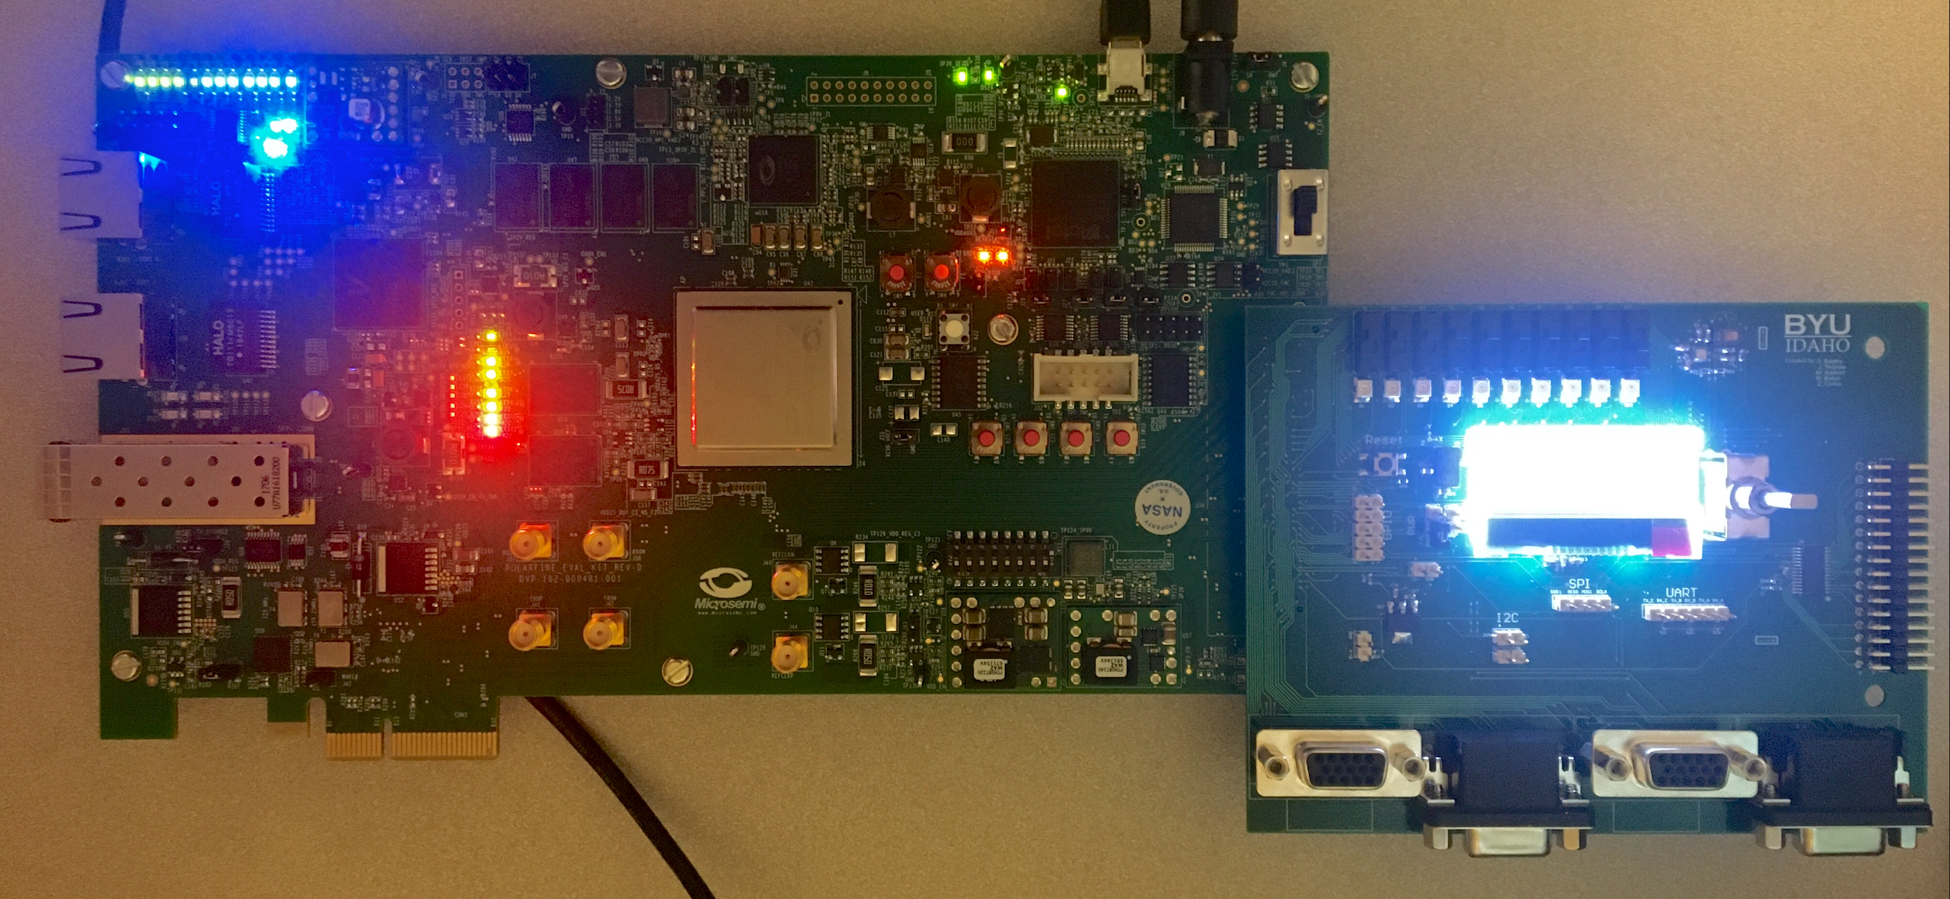
Hardware & Software:
PolarFire FPGA
Libero
SoftConsole
Custom PCB

Slide 6
PCB Assembly:

Slide 7
PCB Assembly:
Problems Overcome:
Got all components connected and tested successfully
Due to world health condition parts were delayed, but made it in time to accomplish some tasks
Problems Not Overcome:
All known issues have been resolved

Slide 8
Libero:
integrates industry standard Synopsys Synplify Pro® synthesis and Mentor Graphics ModelSim® simulation with best-in-class constraints management, Programming & Debug Tools capabilities, and secure production programming support.
Accomplished:
Debugged several module and set them up to work correctly
Configured UART module to be set up for Full-Duplex
Fixed the LVDS UART Module so that it can transmit a differential signal
Yet to be done:
Set up the other three processor design to work with various other memory configurations
Turn LVDS UARTs differential signal into a LVDS signal
Add a LVDS module for receiving data
Fully test SPI and I2C
Fix GPIO I/O configuration

Slide 9
Libero:
integrates industry standard Synopsys Synplify Pro® synthesis and Mentor Graphics ModelSim® simulation with best-in-class constraints management, Programming & Debug Tools capabilities, and secure production programming support.
Problems Overcome:
In order to work on Libero remotely we had to set up a zoom meeting share the Libero screen and request remote access from our computers at home
Change UART configuration to work with a baud rate that is usable with LVDS
Problems Not Overcome:
LVDS UART baud rate/timing isn’t accurate

Slide 10
SoftConsole:
Free software development environment facilitating the rapid development of bare-metal and RTOS based C/C++ software for Microsemi CPU and SoC based FPGAs.
Accomplished:
Further developed a SoftConsole project that can run on the first processor design
Mostly finished driver code for the LCD screen that can possibly run on other core configurations (depending on if the APIs change between processors)
Further developed code for GPIO. Can possibly run on other core configurations (depending on if the APIs change between processors)
Yet to be done:
Write driver code for remaining sensors
Debug test program for LCD screen

Slide 11
SoftConsole:
Free software development environment facilitating the rapid development of bare-metal and RTOS based C/C++ software for Microsemi CPU and SoC based FPGAs.
Problems Overcome:
Properly transmitting data over SPI to communicate with the LCD
Correctly addressing each of the GPIO inputs in order to display current states of peripherals
Problems Not Overcome:
LCD Does not display anything when communicated with. Using an oscilloscope we can confirm that the messages are being sent, and the chip select is being triggered

Slide 12
Future Areas of Improvement:
Libero
Fix issues with full duplex LVDS UART
More architectures
Benchmark CPUs
SoftConsole
Write driver code for remaining sensors
Debug issues with LCD test

Slide 13
Questions?

